Slide 1
Sterling & Draper Video Trending Dashboard
12/02/2024
Source: trending_by_time.csv

Slide 2
Every week we ask same questions
What categories were trending last week ?
How were they distributed through regions ?
What categories are the most popular in certain regions ?

Slide 3
Our objectives
- Analyse historical trending data on YouTube
What frequency data is checked ?
- Every day
Dashboard Content
- Historical trend divide by time and category
- Historical trend by region
- Contingency table between region and category

Slide 4
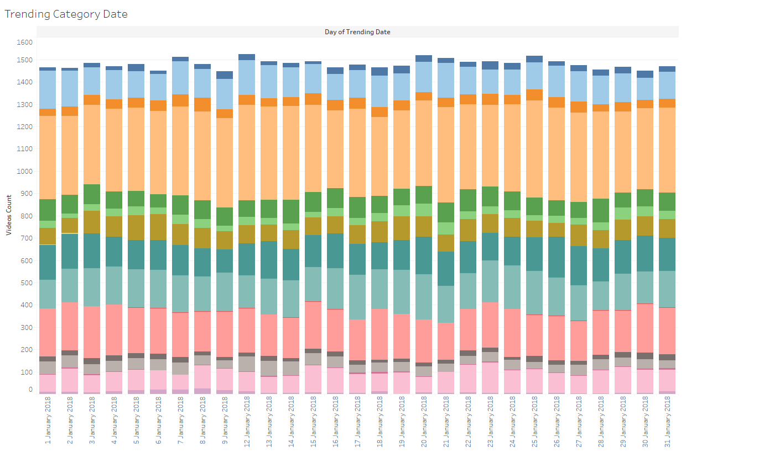

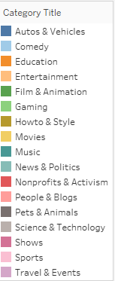
Trending Category Graphic
Filters
Category
Details
Dates
Source: trending_by_time.csv

Slide 5
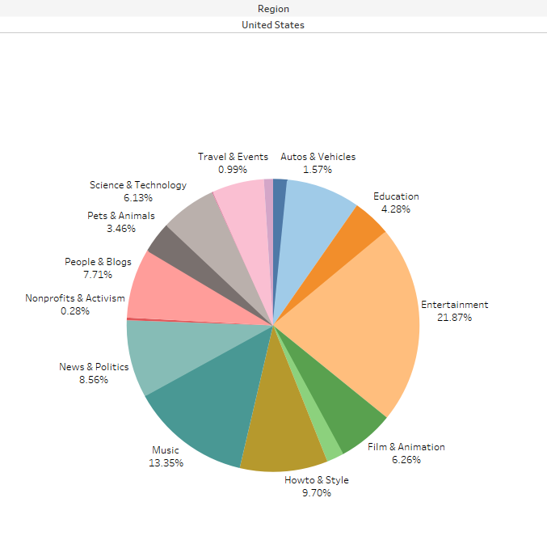
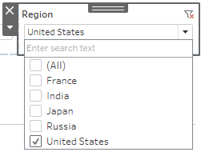

Region Category Pie Chart
Region Filter combined with date
Details
Source: trending_by_time.csv

Slide 6
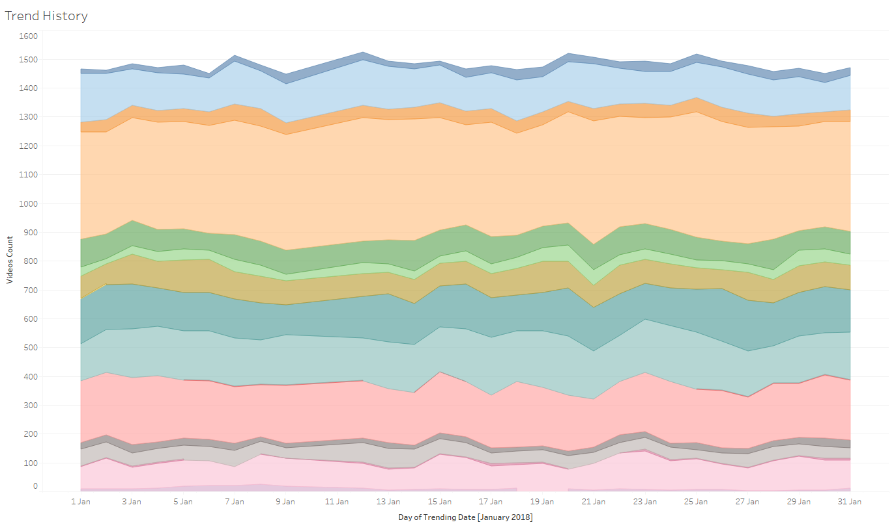

Trend History Graphic
Filters
Details
Categories
Dates
Category title filter when applied highlight chosen category
Source: trending_by_time.csv

Slide 7
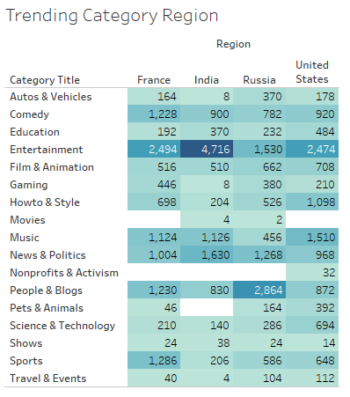

Contingency Table
All these 4 graphics combined in an interaction Dashboard can be an extremely powerful to see patterns and help to drive the marketing budget in a more efficient manner.
Details
All data is updated daily at noon therefore data can be analysed daily.
Source: trending_by_time.csv

Slide 8
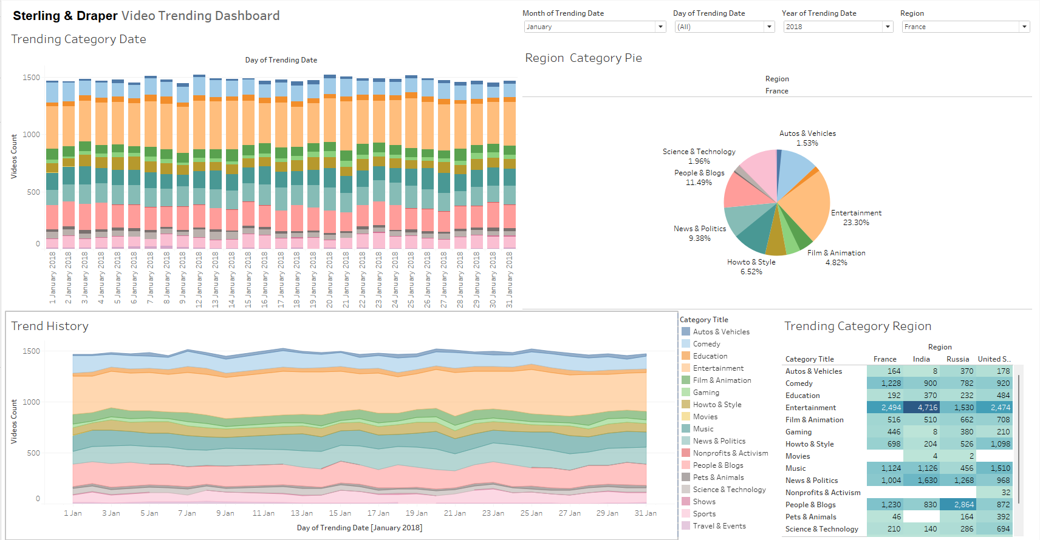
Dashboard Visualization
Filters
Source: trending_by_time.csv
Tableau Public Dashboard Link : https://public.tableau.com/app/profile/renan.ramalho/viz/video_trending_dashboard/VideoTrendingDashoard?publish=yes

Slide 9
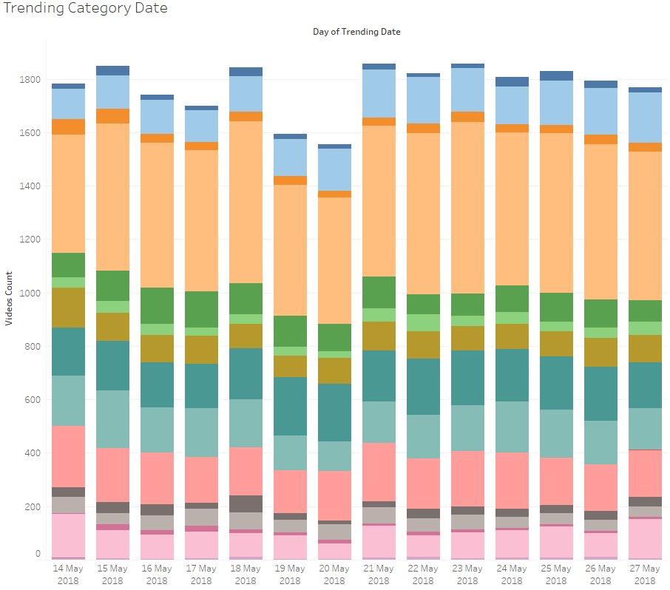

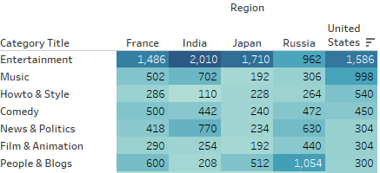
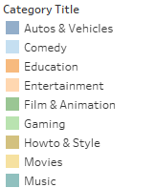
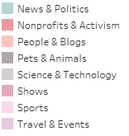
What categories were trend last two weeks ?
Filters were selected to last two weeks of May 2018.
Entertainment is the dominant category on last two weeks floating from 29% up to 34 % of all the videos seen.
India leads the count of entertainment of all regions.
Music makes the second most popular category varying between 9% and 13%.
There is a drop on seen videos on 19th and 20th of May, Sunday and Monday, respectively.
Different from other regions in Russia People & Blogs category is the most popular.
Source: trending_by_time.csv

Slide 10
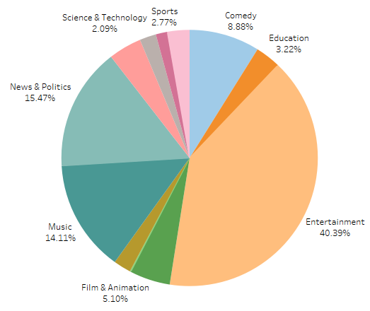
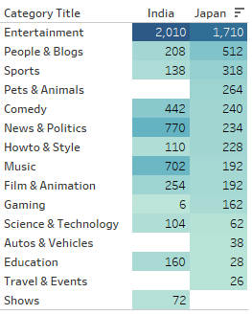
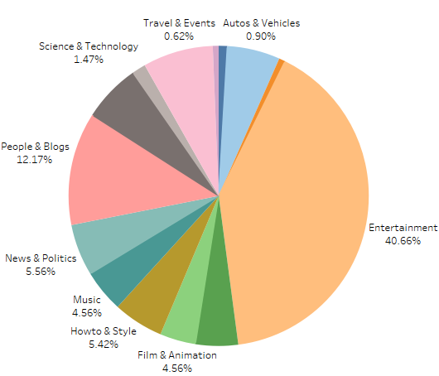
How were the category distribution through regions ?
Comparing countries from the same continent.
Entertainment makes 40% of share in both countries
In Japan, the distribution of the categories are more even apart from Entertainment and People & Blogs, showing a general interest in everything.
In India we see an uneven distribution of the categories.
News & Politics is the second most popular category in India but it’s only 5% of the views in Japan.
People & Blogs is the second most popular category in Japan with 12% of the share whereas in India is only 4%
India
Japan
Source: trending_by_time.csv

Slide 11
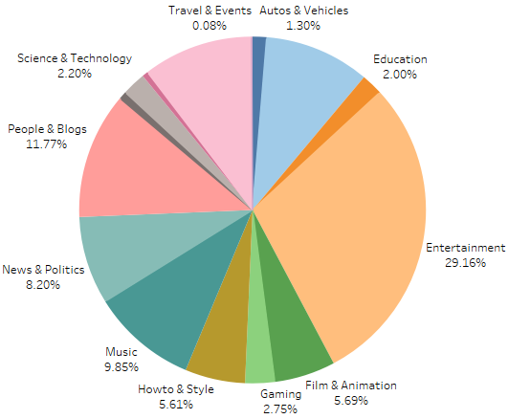
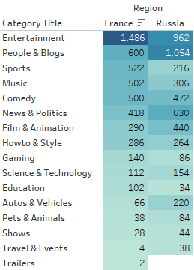
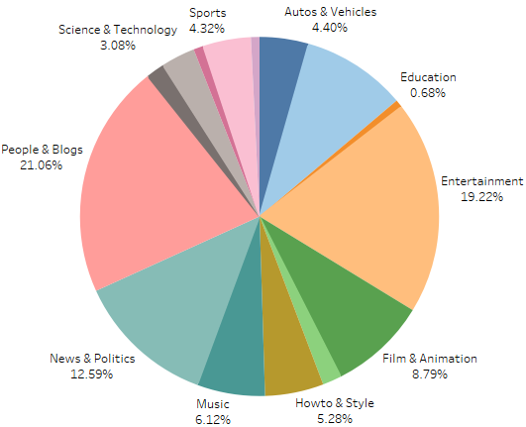
How were the category distribution through regions ?
Entertainment is the most popular category in France with 29%
People & Blog is the most popular category in Russia with 21%
Russia show more interest in News & Politics with 12% when compared with France that shows only 8%
Education is the has the lowest share in Russia 0.68% and only 2% in France
Sports are more popular in France 10% when compared with Russia only 4%
France
Russia
Source: trending_by_time.csv

Slide 12
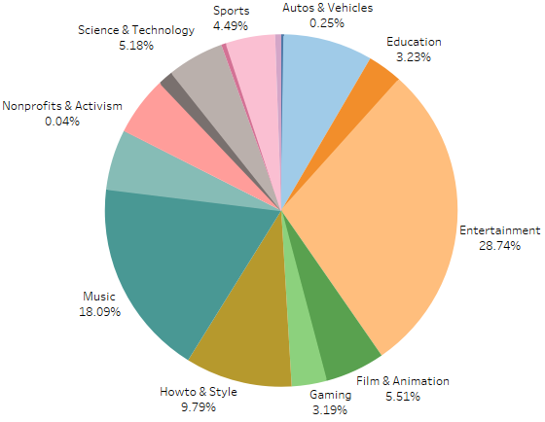
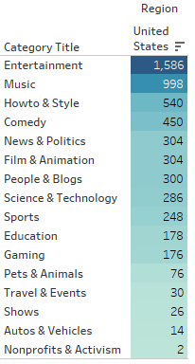
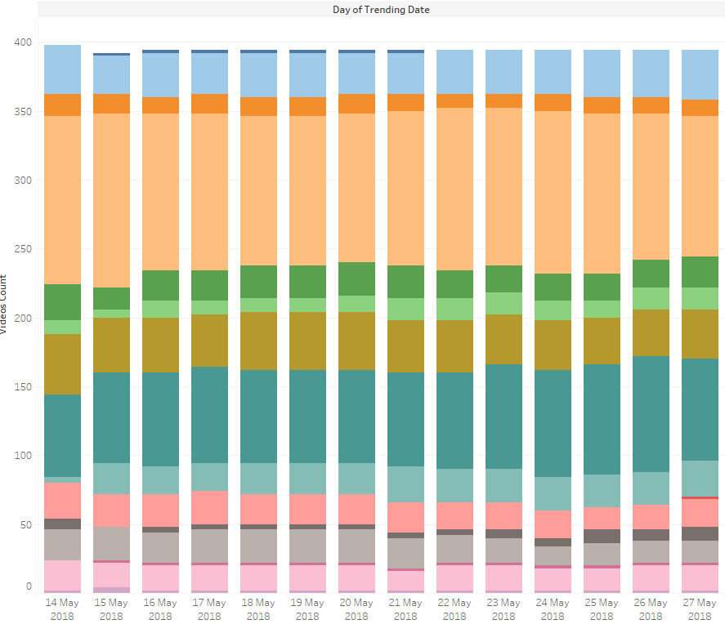
What categories were popular in America?
Entertainment is the most popular category in America with 28%, Music makes the second most popular with 18%
America show even preference distribution on categories through the two weeks selected.
Even distribution between How-to & Style to Sports.
America show low interest in Non-profit & Activism.
Source: trending_by_time.csv

Slide 13
Conclusions & Insights
Entertainment is the most popular category of all regions.
Music, People & Blog, News & Politics and Sports are also popular across different regions.
Significant drop on views across all regions on Sunday and Monday. One of the reasons for this could be, most people are off work on Sundays and tend to do outdoor activities.
India has the most views of all regions.
Marketing should be focused on popular categories.

